Slide 1
Linear modeling I
Stephanie J. spielman, phd
bio5312, Fall 2017

Slide 2
General notes on Homework
Do not use Rstudio-specific commands in R chunks
View() is not an R command
May prevent from knitting
Only set working directory once
Add to top chunk!
Chi-squared assumptions refer to expected counts
Don't give yourself more work than you have to
Don't make your hypotheses fancy
When to use median vs. mean for directional conclusions?

Slide 3
Announcing Final Project (25%)
Identify a dataset and ask four scientific questions about the data
Use any of the statistical approaches we have learned to answer each question
Make a descriptive figure for each scientific question

Slide 4
Scientific questions
Recall HW7:
Do PHA levels tend to differ between the birds that received supplemental carotenoids and those that did not? Based on your results, can you infer anything about immune differences between birds that did and did not receive carotenoids?
Use a Mann Whitney U test to answer the scientific question
"Run a Mann Whitney U test on PHA levels between bird treatments" is not a scientific question
What figure might be good to make here?
What figures would not be good here?

Slide 5
Final project proposal
Homework due 11/28 will be a proposal
Identify your dataset and give 1-2 paragraphs of background
IN YOUR OWN WORDS
Pose four scientific questions
Explain how you will solve each question
What statistical procedure and why
Indicate how you will visualize your data
Around 1 written page, single-spaced.
3-4 sentences total per question

Slide 6
Updated schedule
Date | Topic
10/24 | Linear modeling I
10/31 | Linear modeling II and logistic regression
11/7 | Model selection and evaluation
11/14 | Principal Components Analysis (PCA) and clustering
11/21 | Thanksgiving break
11/28 | Advanced R grabbag and/or overflow
12/5 | Advanced R grabbag and/or in-class office hours for final project Special topic?
12/12 | Final project due (by 11:59 pm on 12/12)

Slide 7
Linear Modeling
ANOVA and friends
Correlation
Regression
Multiple regression

Slide 8
ANOVA: Analysis of Variance
Used to compare more than 2 means (among k groups)
Ho: All means are the same, i.e. 𝜇₁ = 𝜇₂ = … = 𝜇_{k}
Ha: At least one mean is different, i.e. at least one 𝜇_{<1-k>} differs
Why "can't" we use a t-test?
We can do all the comparisons and use a P-value correction
ANOVA is preferred

Slide 9
ANOVA Example
A clinical trial asks if there is a difference in mean daily calcium intake in adults with normal bone density, adults with osteopenia, and adults with osteoporosis. Each participant's daily calcium intake is measured based on reported food intake.
Is there a difference in mean calcium intake across groups?
Normal Bone Density | Osteopenia | Osteoporosis
1200 | 1000 | 490
1000 | 1100 | 650
980 | 700 | 200
900 | 800 | 300
750 | 500 | 400
800 | 700 | 350

Slide 10
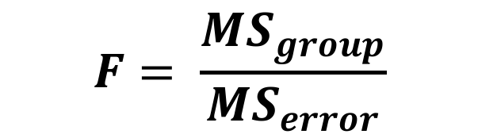
ANOVA compares sources of variance using the F statistic
Variance among groups is the group mean square (MS_{group})
Variance within each group is the error mean square (MS_{error})
Pooled sample variance
MS_{group}
$$F= \frac{{MS}_{group}}{{MS}_{error}}$$
MS_{error}

Slide 11
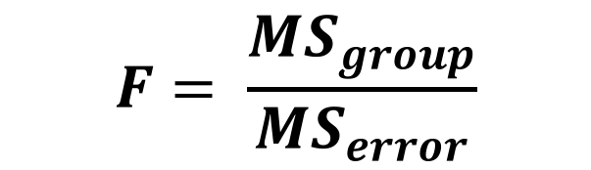
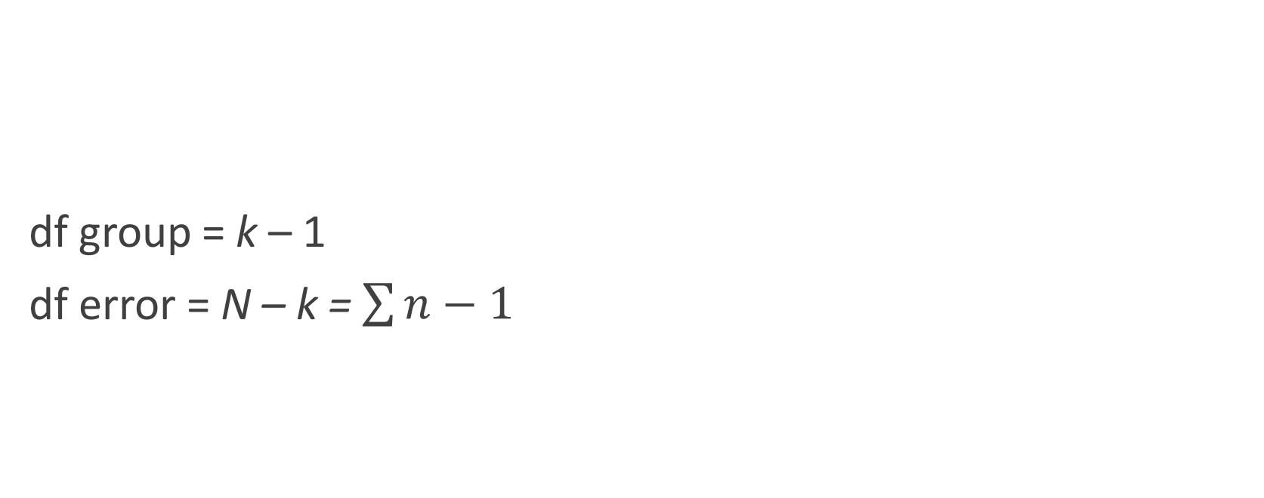
The F statistic
df group = k – 1
df error = N – k = $\sum{n−1}$
$$F= \frac{{MS}_{group}}{{MS}_{error}}$$
We use only the upper tail for P-value
https://en.wikipedia.org/wiki/F-distribution#/media/File:F-distribution_pdf.svg

Slide 12
Interpreting the F statistic
If H_{O} is true, F ≅ 1
MS_{group} ≅ MS_{error}
If H_{O} is false, F > 1
MS_{group} > MS_{error}

Slide 13
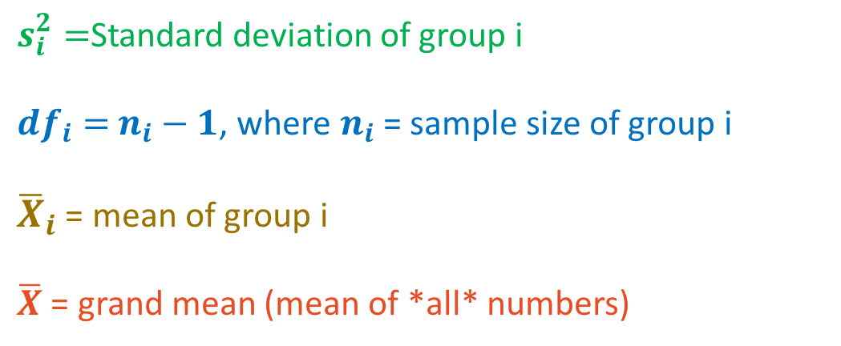
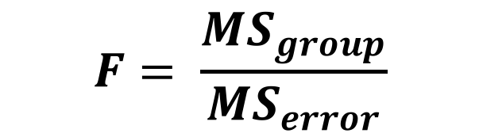
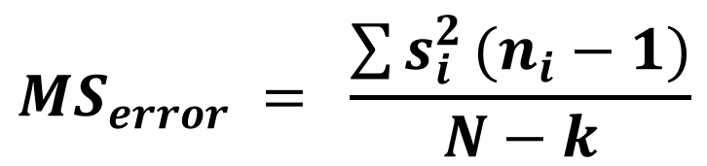
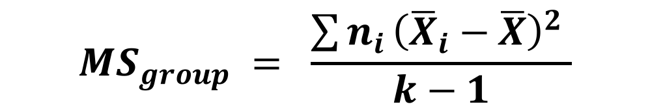
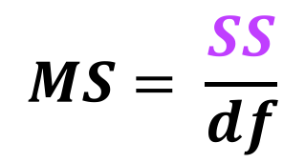
Computing the F statistic
$$F= \frac{{MS}_{group}}{{MS}_{error}}$$
$$MS= \frac{SS}{df}$$
Sum of squares
$s_{i}^{2}=$Standard deviation of group i
${df}_{i}=$ $n_{i}−1$, where $n_{i}$ = sample size of group i
${\overline{X}}_{i}$ = mean of group i
$\overline{X}$ = grand mean (mean of *all* numbers)
$${MS}_{error} = \frac{\sum{s_{i}^{2}}(n_{i}−1)}{N−k}$$
$${MS}_{group} = \frac{\sum{n_{i}}{\left({\overline{X}}_{i}−\overline{X}\right)}^{2} }{k−1}$$

Slide 14
Computing the F statistic
$$F= \frac{{MS}_{group}}{{MS}_{error}}$$
$$MS= \frac{SS}{df}$$
Normal Bone Density | Osteopenia | Osteoporosis
1200 | 1000 | 490
1000 | 1100 | 650
980 | 700 | 200
900 | 800 | 300
750 | 500 | 400
800 | 700 | 350
$${MS}_{error} = \frac{\sum{s_{i}^{2}}(n_{i}−1)}{N−k}$$
$${MS}_{group} = \frac{\sum{n_{i}}{\left({\overline{X}}_{i}−\overline{X}\right)}^{2} }{k−1}$$

Slide 15
Running the ANOVA
Ho: Groups have the same mean calcium intake.
Ha: At least one group has a different calcium intake.
group calcium
1 normal 1200
2 normal 1000
3 normal 980
4 normal 900
5 normal 750
6 normal 800
7 osteopenia 1000
8 osteopenia 1100
9 osteopenia 700
10 osteopenia 800
11 osteopenia 500
12 osteopenia 700
...
data <- tibble("normal" = c(1200, 1000, 980, 900, 750, 800),
"osteopenia" = c(1000, 1100, 700, 800, 500, 700),
"osteoporosis" = c(490, 650, 200, 300, 400, 350))
data %>% gather(group, calcium, normal:osteoporosis) -> tidy.data

Slide 16
Visualize the data
It is always the right idea to view your data before modeling it
ggplot(tidy.data, aes(x = group, y = calcium, fill= group)) + geom_violin()

Slide 17
Running the ANOVA
> aov(calcium ~ group, data = tidy.data)
Call:
aov(formula = calcium ~ group, data = tidy.data)
Terms:
group Residuals
Sum of Squares 944144.4 493166.7
Deg. of Freedom 2 15
Residual standard error: 181.3223
Estimated effects may be unbalanced
error

Slide 18
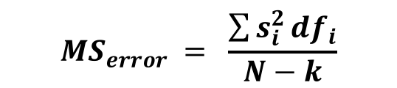
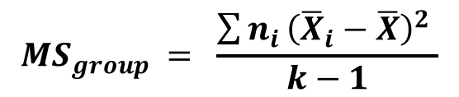
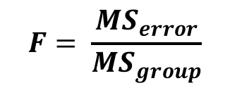
Obtaining the ANOVA table
> summary( aov(calcium ~ group, data = tidy.data) )
Df Sum Sq Mean Sq F value Pr(>F)
group 2 944144 472072 14.36 0.000328 ***
Residuals 15 493167 32878
---
Signif. codes: 0 ‘***’ 0.001 ‘**’ 0.01 ‘*’ 0.05 ‘.’ 0.1 ‘ ’ 1
> 1-pf(14.36, 2, 15)
[1] 0.0003277806
error
$${MS}_{group} = \frac{\sum{n_{i}}{\left({\overline{X}}_{i}−\overline{X}\right)}^{2} }{k−1}$$
$${MS}_{error} = \frac{\sum{s_{i}^{2}}{df}_{i}}{N−k}$$
$$F= \frac{{MS}_{error}}{{MS}_{group}}$$

Slide 19
Reports and conclusions
Our P = 0.000328, which is less than alpha. We reject the null hypothesis and we have evidence that at least one mean (normal bone density, osteopenia, or osteoporosis calcium intake) differs from the other.

Slide 20
Unplanned comparisons with the Tukey-Kramer Method
AKA Tukey's test, Tukey's method, Tukey's HSD (honest significant difference) test
Tests all pairs of means
Normal vs. osteopenia
Normal vs. osteoporosis
Osteopenia vs. osteoporosis
Roughly, multiple t-tests where FWER is controlled but using the q-statistic (similar to t)

Slide 21
Running Tukey's test on ANOVA
> TukeyHSD( aov(calcium ~ group, data = tidy.data) )
Tukey multiple comparisons of means
95% family-wise confidence level
Fit: aov(formula = calcium ~ group, data = tidy.data)
$group
diff lwr upr p adj
osteopenia-normal -138.3333 -410.2534 133.5867 0.4054988
osteoporosis-normal -540.0000 -811.9200 -268.0800 0.0003238
osteoporosis-osteopenia -401.6667 -673.5867 -129.7466 0.0043335

Slide 22
Reports and conclusions, round 2
Our P = 0.000328, which is less than alpha. We reject the null hypothesis and we have evidence that at least one mean (normal bone density, osteopenia, or osteoporosis calcium intake) differs from the other.
After running the post-hoc Tukey's test, we find that osteoporosis groups have a significantly higher average calcium intake than normal groups (P=0.0003), and that osteoporosis groups have a significantly higher average calcium intake than osteopenia groups P=0.004). However, we do not find a significant difference in calcium intake between normal and osteopenia groups.

Slide 23
ANOVA assumptions
Samples are random
Samples are normally distributed
Robust to violations when study is large
Samples have the same variance
Robust to violations when study is balanced

Slide 24
Kruskal-Wallis is the non-parametric alternative
> kruskal.test(calcium ~ as.factor(group), data = tidy.data)
Kruskal-Wallis rank sum test
data: calcium by as.factor(group)
Kruskal-Wallis chi-squared = 11.439, df = 2, p-value = 0.003281
Unless something is really really weird, you "can" use ANOVA

Slide 25
Exercise break

Slide 26
Correlation
Measures the strength and direction of the linear association between two numeric variables
-1 ≤ r ≤ 1

Slide 27
Perfect correlations
r = 1
r = -1

Slide 28
Variability (error) has a substantial influence

Slide 29
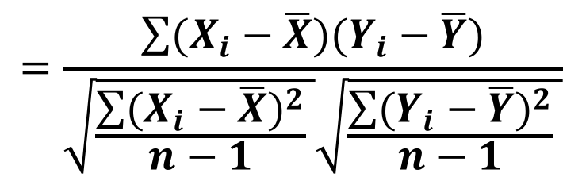
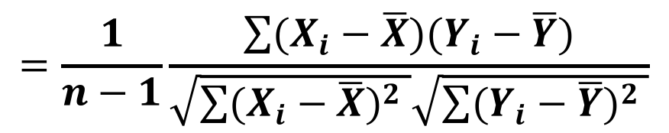
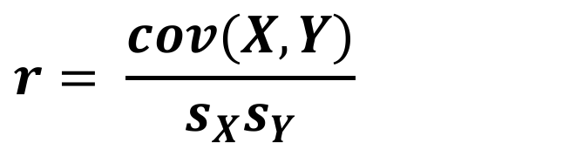
Calculating the correlation coefficient
$$r= \frac{cov(X,Y)}{s_{X}s_{Y}}$$
$$=\frac{\sum{(X_{i}−\overline{X})(Y_{i}−\overline{Y})}}{\sqrt{\frac{\sum{{(X_{i}−\overline{X})}^{2}}}{n−1} }\sqrt{\frac{\sum{{(Y_{i}−\overline{Y})}^{2}}}{n−1} }}$$
$$=\frac{1}{n−1}\frac{\sum{(X_{i}−\overline{X})(Y_{i}−\overline{Y})}}{\sqrt{\sum{{(X_{i}−\overline{X})}^{2}} }\sqrt{\sum{{(Y_{i}−\overline{Y})}^{2}} }}$$

Slide 30
Example: correlation between irises
> setosa <- iris %>% filter(Species == "setosa")
> cor(setosa$Sepal.Length, setosa$Sepal.Width)
[1] 0.7425467
> cor(setosa$Sepal.Width, setosa$Sepal.Length)
[1] 0.7425467

Slide 31
Example: correlation between irises
> cor(setosa$Petal.Length, setosa$Sepal.Width)
[1] 0.1777

Slide 32
Hypothesis testing with correlations
H_{O}: Petal length and sepal width are not correlated (r=0)
H_{A}: Petal length and sepal width are correlated (r!=0)
> cor.test(setosa$Sepal.Width, setosa$Sepal.Length)
Pearson's product-moment correlation
data: setosa$Sepal.Width and setosa$Sepal.Length
t = 7.6807, df = 48, p-value = 6.71e-10
alternative hypothesis: true correlation is not equal to 0
95 percent confidence interval:
0.5851391 0.8460314
sample estimates:
cor
0.7425467
With P=6.7e-10, which is much less than 0.05, we reject the null hypothesis. We find evidence that setosa sepal widths and sepal lengths are corrected. The correlation coefficient r=0.74, with a 95% CI of [0.58, 0.85] This value is above 0, indicating a positive relationship, and it is fairly large, indicating a strong correlation.

Slide 33
Hypothesis testing
> cor.test(setosa$Petal.Length, setosa$Sepal.Width)
Pearson's product-moment correlation
data: setosa$Petal.Length and setosa$Sepal.Width
t = 1.2511, df = 48, p-value = 0.217
alternative hypothesis: true correlation is not equal to 0
95 percent confidence interval:
-0.1058851 0.4345536
sample estimates:
cor
0.1777
We fail to reject the null hypothesis. There is no evidence that the correlation between petal lengths and sepal width in setosa irises differs from 0.

Slide 34
Nonlinear data

Slide 35
Nonlinear data
> cor.test(x, y)
Pearson's product-moment correlation
data: x and y
t = 13.089, df = 48, p-value < 2.2e-16
alternative hypothesis: true correlation is
not equal to 0
95 percent confidence interval:
0.8030401 0.9327180
sample estimates:
cor
0.8838302

Slide 36
Spearman rank nonparametric correlation
Assumes data is monotonic (ordinal)
> cor.test(x, y, method = "spearman" )
Spearman's rank correlation rho
data: x and y
S = 0, p-value < 2.2e-16
alternative hypothesis: true rho is not equal to 0
sample estimates:
rho
1

Slide 37
Assumptions: Check by plotting
Data are linearly related without any severe outliers
Both X and Y are normally distributed
Robust to large N
Cloud of points is not "funnel-shaped" (fans out at end(s))

Slide 38
Exercise break

Slide 39
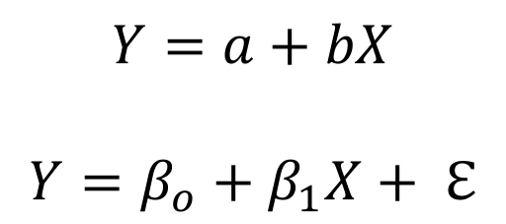
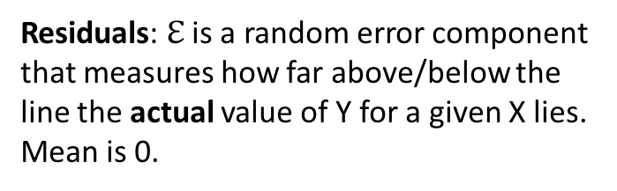
Regression
The simplest type of linear model
Predicts the value of one numeric variable from another via "line of best fit"
$$Y=a+bX$$
$$Y=β_{o}+β_{1}X+ ℇ$$
Residuals: $ℇ$ is a random error component that measures how far above/below the line the actual value of Y for a given X lies. Mean is 0.

Slide 40
Least squares approach
Find the line which minimizes the sum of squared residuals

Slide 41
Least squares approach
Find the line which minimizes the sum of squared residuals

Slide 42
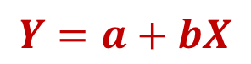
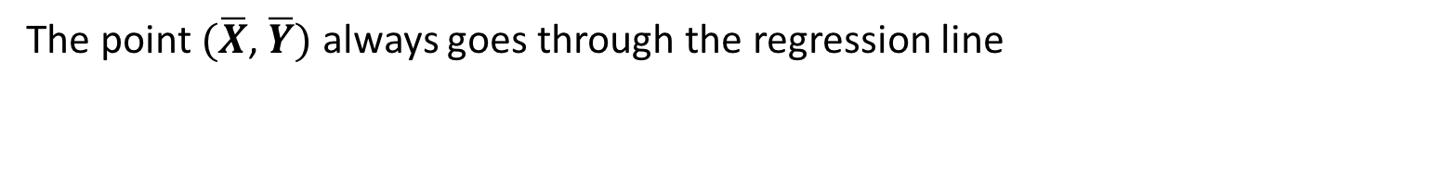
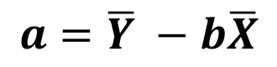
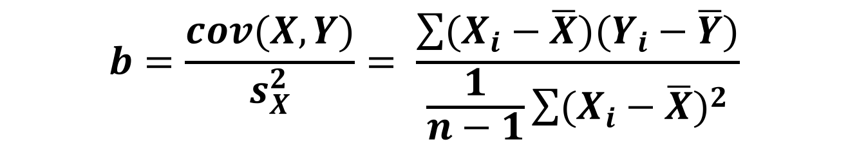
Calculating slope and intercept
$$Y=a+bX$$
$$b=\frac{cov(X,Y)}{s_{X}^{2}}= \frac{\sum{(X_{i}−\overline{X})(Y_{i}−\overline{Y})}}{\frac{1}{n−1}\sum{{(X_{i}−\overline{X})}^{2}}}$$
$$a=\overline{Y} −b\overline{X}$$
The point $(\overline{X}$, $\overline{Y})$ always goes through the regression line

Slide 43
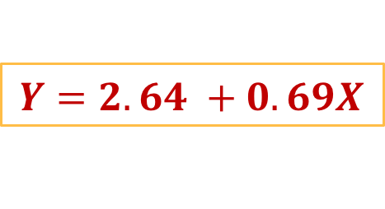
Executing a linear model
### lm(Y ~ X, data = <data frame>) ###
> lm(Sepal.Length ~ Sepal.Width, data = setosa)
Call:
lm(formula = Sepal.Length ~ Sepal.Width, data = setosa)
Coefficients:
(Intercept) Petal.Width
2.6390 0.6905
$$Y=2.64 +0.69X$$

Slide 44
Testing a linear model
> summary( lm(Sepal.Length ~ Sepal.Width, data = setosa) )
Call:
lm(formula = Sepal.Length ~ Sepal.Width, data = setosa)
Residuals:
Min 1Q Median 3Q Max
-0.52476 -0.16286 0.02166 0.13833 0.44428
Coefficients:
Estimate Std. Error t value Pr(>|t|)
(Intercept) 2.6390 0.3100 8.513 3.74e-11 ***
Sepal.Width 0.6905 0.0899 7.681 6.71e-10 ***
---
Signif. codes: 0 ‘***’ 0.001 ‘**’ 0.01 ‘*’ 0.05 ‘.’ 0.1 ‘ ’ 1
Residual standard error: 0.2385 on 48 degrees of freedom
Multiple R-squared: 0.5514, Adjusted R-squared: 0.542
F-statistic: 58.99 on 1 and 48 DF, p-value: 6.71e-10
Five number summary of the distribution of residuals
SE of $ℇ$
Test for model improvement over slope=0

Slide 45
Coefficients
Y
X
lm(Sepal.Length ~ Sepal.Width)
Test for null hypothesis that coefficient != 0
Coefficients:
Estimate Std. Error t value Pr(>|t|)
(Intercept) 2.6390 0.3100 8.513 3.74e-11 ***
Sepal.Width 0.6905 0.0899 7.681 6.71e-10 ***
Expected value of Y when X=0
Expected unit increase in Y for
every 1 unit increase in X
What can we conclude?
On average, setosa Sepal Length (Y) increases by 0.6905 cm (+/-0.0899 SE) for every 1 cm of Sepal Width (X).
[If P < alpha, don't conclude this..]

Slide 46
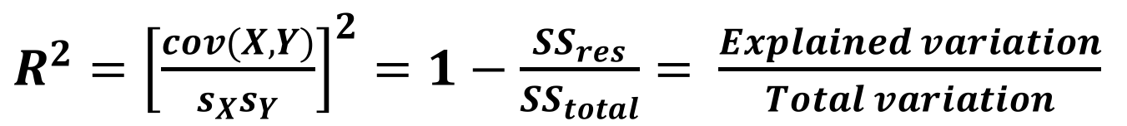
R²
R² is the percent of variation in Y than can be explained by X
0 ≤ R² ≤ 1
Multiple R-squared: 0.5514, Adjusted R-squared: 0.542
$R^{2}={\left[\frac{cov(X,Y)}{s_{X}s_{Y}}\right]}^{2}=1−\frac{{SS}_{res}}{{SS}_{total}}= \frac{Explained variation}{Total variation}$
What can we conclude?
~55% of the variation in Setosa sepal lengths (Y) can be explained by Setosa sepals widths (X).
[If P < alpha, don't conclude this..]

Slide 47
Broom to the rescue
> summary( lm(Sepal.Length ~ Sepal.Width, data = setosa) )
Call:
lm(formula = Sepal.Length ~ Sepal.Width, data = setosa)
Residuals:
Min 1Q Median 3Q Max
-0.52476 -0.16286 0.02166 0.13833 0.44428
Coefficients:
Estimate Std. Error t value Pr(>|t|)
(Intercept) 2.6390 0.3100 8.513 3.74e-11 ***
Sepal.Width 0.6905 0.0899 7.681 6.71e-10 ***
---
Signif. codes: 0 ‘***’ 0.001 ‘**’ 0.01 ‘*’ 0.05 ‘.’ 0.1 ‘ ’ 1
Residual standard error: 0.2385 on 48 degrees of freedom
Multiple R-squared: 0.5514, Adjusted R-squared: 0.542
F-statistic: 58.99 on 1 and 48 DF, p-value: 6.71e-10

Slide 48
Broom to the rescue
> library(broom)
> model <- lm(Sepal.Length ~ Sepal.Width, data = setosa)
##### Coefficients and Pvalues #####
> tidy(model)
term estimate std.error statistic p.value
1 (Intercept) 2.6390012 0.31001431 8.512514 3.742438e-11
2 Sepal.Width 0.6904897 0.08989888 7.680738 6.709843e-10
##### Concise *one row* summary #####
> glance(model)
r.squared adj.r.squared sigma statistic p.value df logLik AIC
1 0.5513756 0.5420292 0.2385422 58.99373 6.709843e-10 2 1.734067 2.531865
BIC deviance df.residual
1 8.267934 2.731315 48

Slide 49
Broom to the rescue
##### Add columns from fit to the original data that was modeled #####
> augment(model)
Sepal.Length Sepal.Width .fitted .se.fit .resid .hat .sigma .cooksd .std.resid
1 5.1 3.5 5.055715 0.03435031 0.04428474 0.02073628 0.2409782 3.726311e-04 0.18760265
2 4.9 3.0 4.710470 0.05117134 0.18952960 0.04601750 0.2393991 1.596010e-02 0.81347001
3 4.7 3.2 4.848568 0.03947370 -0.14856834 0.02738325 0.2400630 5.614273e-03 -0.63152438
4 4.6 3.1 4.779519 0.04480537 -0.17951937 0.03528008 0.2395878 1.073468e-02 -0.76620575
5 5.0 3.6 5.124764 0.03710984 -0.12476423 0.02420180 0.2403616 3.476539e-03 -0.52947419
6 5.4 3.9 5.331911 0.05420835 0.06808885 0.05164186 0.2408507 2.339099e-03 0.29310589

Slide 50
Visualizing the regression
ggplot(setosa, aes(x = Sepal.Width, y = Sepal.Length)) +
geom_point() + geom_smooth(method = "lm")

Slide 51
Visualizing the regression
ggplot(setosa, aes(x = Sepal.Width, y = Sepal.Length)) +
geom_point() + geom_smooth(method = "lm") +
geom_text(x = 2.75, y = 5.5, label = "y=2.639 + 0.69x", color="red")

Slide 52
Visualizing the regression
ggplot(setosa, aes(x = Sepal.Width, y = Sepal.Length)) +
geom_point() + geom_smooth(method = "lm") +
geom_text(x=2.75, y=5.5, label="r^2 == 0.585", parse=TRUE, color="red")

Slide 53
Using the model: Predicting responses
What is sepal length for a sepal width of 2.6?
> model <- lm(Sepal.Length ~ Sepal.Width, data = setosa)
> new.data <-tibble(Sepal.Width = 2.6) ## Same column name as model's predictor
> predict(model, new.data)
1
4.434275

Slide 54
Predicting with intervals
Confidence interval
Range that is likely to contain the mean response
Prediction interval
Range that is likely to contain the response value of a single new observation
Wider than CI due to added uncertainty for predicting a single point

Slide 55
Predicting with intervals
> predict(model, new.data)
1
4.434275
> predict(model, new.data, interval = "confidence")
fit lwr upr
1 4.434275 4.269957 4.598592
> predict(model, new.data, interval = "predict")
fit lwr upr
1 4.434275 3.927287 4.941262
> predict(model, new.data, interval = "confidence", level = 0.9)
fit lwr upr
1 4.434275 4.297205 4.571344

Slide 56
Assumptions of linear models
Residuals are normally distributed
The variance is the same for all predictors*
Predictors are independent of each other*
The relationship between response and any numeric predictors is linear*

Slide 57
Normality of residuals
> augmented <- augment(model)
> qqnorm(augmented$.resid)
> qqline(augmented$.resid)

Slide 58
How to check regression assumptions
Plot response and predictor against each other to ensure linearity
Critically important
Plot the residuals to ensure normality
Important, usually overlooked
Most times we are robust to departures

Slide 59
Exercise break

Slide 60
Linear Models
lm(Numeric response ~ <predictors>)

Slide 61
Linear Models
Single numeric predictor: Regression
Single categorical predictor: ANOVA
Multiple numeric predictors: multiple regression
Multiple categorical predictors: n-way ANOVA
Single categorical and n numeric predictors: ANCOVA
Multiple categorical and n numeric predictors: linear model
lm(Numeric response ~ <predictors>)

Slide 62
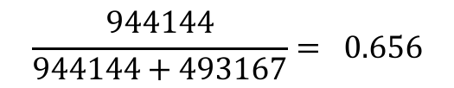
ANOVA meets linear modeling
group calcium
1 normal 1200
2 normal 1000
3 normal 980
4 normal 900
5 normal 750
6 normal 800
7 osteopenia 1000
8 osteopenia 1100
9 osteopenia 700
10 osteopenia 800
11 osteopenia 500
12 osteopenia 700
...
> summary(aov(calcium ~ group, data = tidy.data))
Df Sum Sq Mean Sq F value Pr(>F)
group 2 944144 472072 14.36 0.000328 ***
Residuals 15 493167 32878
$$\frac{944144}{944144+493167}= 0.656$$
> summary(lm(calcium ~ group, data = tidy.data))
Coefficients:
Estimate Std. Error t value Pr(>|t|)
(Intercept) 938.33 74.02 12.676 2.04e-09 ***
grouposteopenia -138.33 104.69 -1.321 0.206168
grouposteoporosis -540.00 104.69 -5.158 0.000117 ***
Residual standard error: 181.3 on 15 degrees of freedom
Multiple R-squared: 0.6569, Adjusted R-squared: 0.6111
F-statistic: 14.36 on 2 and 15 DF, p-value: 0.000328
On average, the normal group consumes 938.33 calcium
Compared to the normal group, the osteopenia group consumes on average -138.33 less calcium.
Compared to the normal group, the osteoporosis group consumes on average -540 less calcium.
Which group you belong to explains ~66% of the variation in calcium intake

Slide 63
Briefly, bootstrapping the regression
> library(slipper)
> setosa %>%
slipper_lm(Sepal.Length ~ Sepal.Width, B=1e3)%>% head()
term value type
1 (Intercept) 2.6390012 observed
2 Sepal.Width 0.6904897 observed
3 (Intercept) 2.0900929 bootstrap
4 Sepal.Width 0.8467474 bootstrap
5 (Intercept) 2.7629316 bootstrap
6 Sepal.Width 0.6527575 bootstrap
setosa %>%
slipper_lm(Sepal.Length ~ Sepal.Width, B=1e3) %>%
filter(type == "bootstrap", term == "Sepal.Width") %>%
summarize(mean = mean(value),
ci_low = quantile(value,0.025),
ci_high = quantile(value,0.975))
mean ci_low ci_high
1 0.6945918 0.5302098 0.8961058

